Slide 1



Linux Bootcamp 2019
JAY PATEL
RHCSA, RHCE

Slide 2

LiNuX History
Father of Linux : “Linus Torvalds”
Invented in 1991 at University of Helsinki
Project named as “Linux Kernel”
Linux Kernel is written in C Language

Slide 3
WHY Linux ?
Free for download; no licensing issues or costs
Freedom to share with your neighbor
Impervious to viruses
Full suite of software applications
Low resource use on hardware side
Ported to a large number of hardware platforms: x86, x64, ARM, PowerPC, MIPS, S/390, Super H, AMD x86-64, VAX
Easy to use
Available in almost any language-
Flexible: can be run on everything from watches to supercomputers

Slide 4
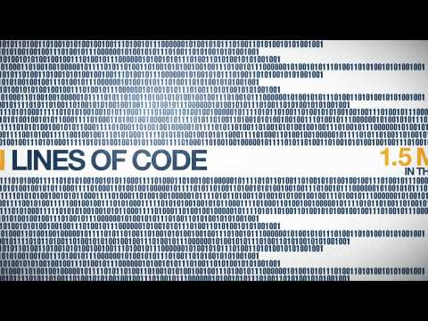
How Linux is Built By The Linux Foundation
Based on the annual report "Who Writes Linux," this is a powerful and inspiring story of how Linux has become a community-driven phenomenon

Slide 5

Linux Has Many Distributions

Slide 6

Redhat is only paid linux in Linux distributions and free version and community driven linux is Centos 7

Slide 7
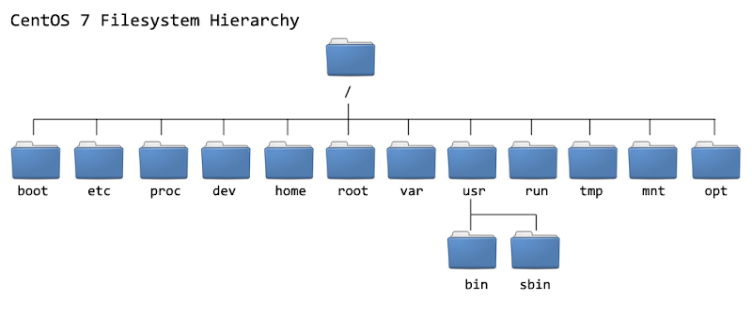
The Linux File System Hierarchy

Slide 8
Basic Commands for navigating files
ls: List content of the directory
cd: Change directory
mkdir: Make directory at the given location
pwd: Present working directory
cp: copy file or folder to the given location
mv: move file or folder to the given location
rmdir: remove directory
rm: remove file
head: returns the given file’s n lines from the start
tail: returns the given file’s n lines from the end
wc: Count lines, words and characters in a file
touch: change the last modified of the file

Slide 9
Output to file
>file: redirect stdout to overwrite a file
>>file: redirect stdout to append a file
2>file: redirect stderr to overwrite a file
2>/dev/null: discard stderr error messages by redirecting to /dev/null
&>file: redirect stdout and stderr to overwrite the same file
&>>file: redirect stdout and stderr to append the same file

Slide 10
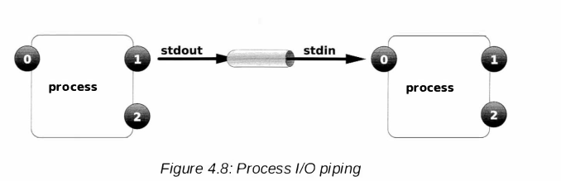
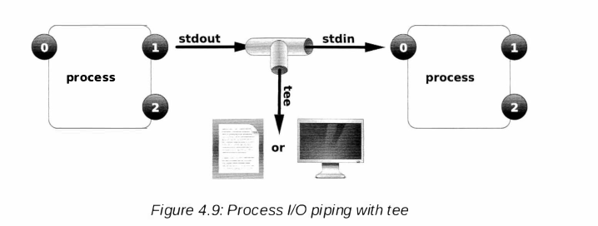
pipeline
ls - l /usr/bin I less
ls - 1 I tee /tmp/saved - ou tput

Slide 11
User Properties
The data of all the user are saved in the file /etc/passwd and their respective passwords in the file /etc/shadow. /etc/passwd file contains the following attributes about user
Username
Password
UID
GID
GESCOS
/home/dir
shell

Slide 12
Group
List of all the groups present in the system are listed in the file /etc/group.
Types:
Primary Group
Supplementary Group
Properties:
Id
Group Name

Slide 13
Basic Command for user and group manipulation
id
Useradd
Userdel
usermod
Passwd
Groupadd
Groupmod
Chage
$HOME
$PATH

Slide 14
Superuser/root/admin
The user with the administrative privileges is known as root.
Accessing as root via shell:
sudo <command>

Slide 15
Switching User
We can run any command as any user if we know the credentials of the account using “su” command.
SU : Switch User
su [-] <username>

Slide 16
File Permissions
Chmod
Chown
Chgrp

Slide 17
CONTROLLING SERVICES AND
DAEMONS
Daemons and Sockets
Service - .service extension
Init or systemd
Tree command
Systemctl start service name
Systemctl status service name
Systemctl enable service name
Getent

Slide 18
INSTALLING AND UPDATING
SOFTWARE PACKAGES
Yum and rpm Yellowdog updater modified and redhat package manager
Repodata - /etc/yum.repos.d
Yum install package name
Yum update package name
Yum repolist
Yum localinstall
How to create repo for packages using .repo

Slide 19
[localrepo]
name=Unixmen Repository
baseurl=file:///var/ftp/pub/localrepo
gpgcheck=0
enabled=1

Slide 20
Scheduling Future Linux Tasks
Crontab -L
Crontab -r
Crontab -e

Slide 21
Linux Root Password Crack Process
Rd.break console=tty1
Mount -oremount,rw /sysroot
Chroot /sysroot
Passwd root
Touch /.autorelabel
exit

Slide 22
Thank you
Feedback link : bit.ly/2DdVDfm

